Slide 1
INTERNET OF THINGS (18EC64) MODULE-1
NISCHITHA s
ASSISTANT PROFESSOR,
Dept. Of e and c

Slide 2
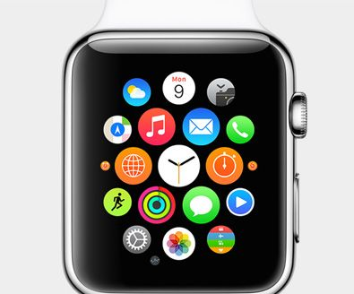
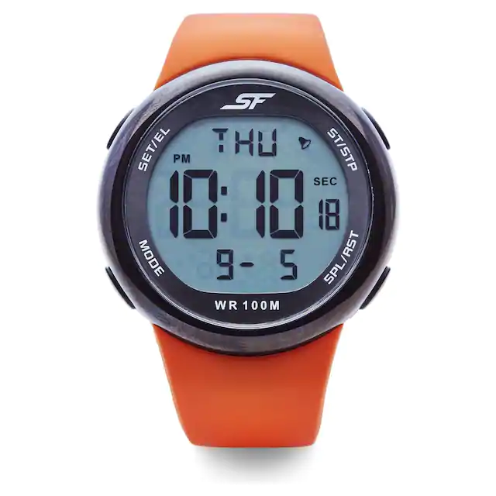
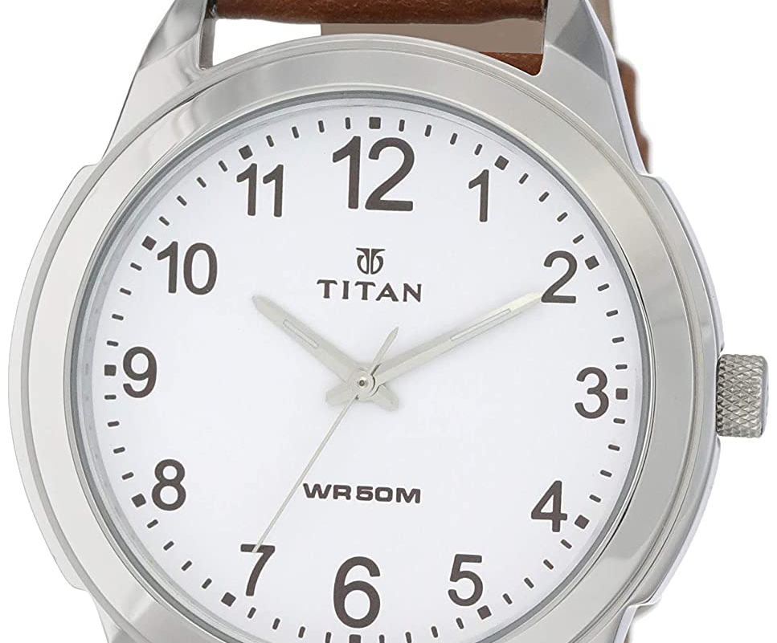
List the differences

Slide 4
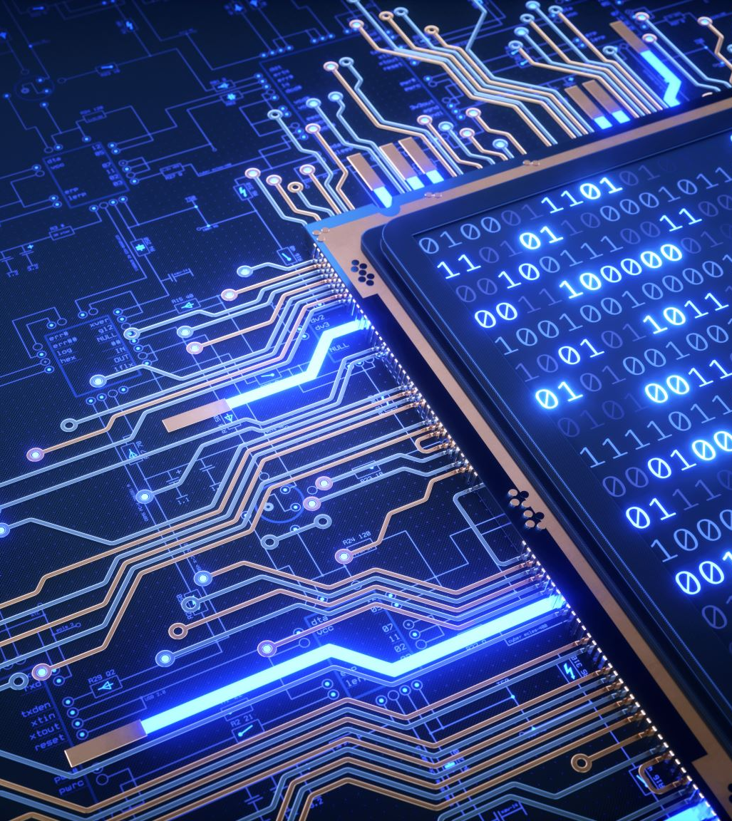
What is IOT?
Goal-->"connect the unconnected"
Object-->smarter-->connect them to internet-->through them sense and control physical world
Objects and machine can be sensed and controlled remotely across a network--> improves efficiency, accuracy, automation and enable in the development of advanced applications.
IOT is not a single technology

Slide 5
Genisis of IOT
Intelligent Connections

Slide 7
IOT and DIGITIZATION
IoT focuses on connecting things
Digitization focuses on connection of “things” with the data they generate and the business insights that result
Example: Wi-Fi location tracking in a mall
Digitization, as defined in its simplest form, is the conversion of information into a digital format

Slide 8
For example,
--> the whole photography industry has been digitized
--> video rental industry
Digitization brings together things, data, and business
process to make networked connections more relevant and valuable.
IoT is a prime enabler of digitization.
Smart objects and increased connectivity drive digitization, and this is one of the main reasons that many companies, countries, and governments are embracing this growing trend.

Slide 9
Convergence of IT and OT

Slide 10
IOT Challenges

Slide 11
IOT Challenges Continued...

Slide 12
IOT Network Architecture and Design
Unique challenges by IOT networks
Drivers Behind New Network Architectures
Comparing IoT Architectures.
A Simplified IoT Architecture
The Core IoT Functional Stack
IoT Data Management and Compute Stack

Slide 13
Drivers behind new Network Architectures

Slide 15
Comparing Architectures: one M2M IOT Architecture

Slide 16
The IoT World Forum (IoTWF) Standardized Architecture

Slide 20
IT and OT Responsibilities in the IoT Reference Model

Slide 21
Additional IoT Reference Models

Slide 22
A Simplified IOT Architecture

Slide 23
Layer 1: Things: Sensors and Actuators Layer
Battery-powered or power-connected
Mobile or static
Low or high reporting frequency
Simple or rich data
Report range
Object density per cell

Slide 24
Example of Sensor Applications Based on Mobility and Throughput

Slide 25
Layer 2: Communications Network Layer
Access Technologies and Distances

Slide 26
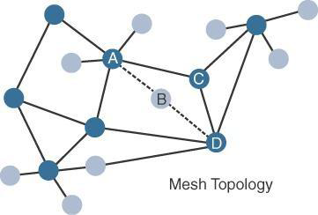
Topologies

Slide 27
Architectural Considerations for WiMAX and Cellular Technologies

Slide 28
Layer 3: Applications and Analytics Layer
Analytics Versus Control Applications
Data Versus Network Analytics
Data Analytics Versus Business Benefits
Smart Services

Slide 29
IOT DATA MANAGEMENT AND COMPUTE STACK
MINIMIZING LATENCY
CONSERVNG NETWORK BANDWIDTH
INCREASING LOCAL EFFICIENCY.
PROBLEMS THAT ARISE
BANDWIDTH IS LIMITED. NETWORK BACKHAUL UNAVILABLE
LATENCY HIGH.. DATA TRNSMITTED CAN BE HIGH.. BIG DATA GETTING BIGGER

Slide 30
Traditional IT Cloud Computing Model

Slide 31
FOG COMPUTING

Slide 32
Defining characteristics for FOG Computing
Contextual location awareness and low latency
Geographic distribution
Development near IOT endpoints
Wireless Communication between the fog and IOT endpoints
Use for real time interaction

Slide 33
Edge Computing

Slide 34
Most time sensitive data is analysed at edge or fog node
Data that can wait seconds or minutes for action is passed along to an aggregation node for analysis and action
Data that is less time sensitive is sent to the cloud for historical analysis, big data analytics, and long-term storage.

